Slide 1

Elementary Enrollment and
Student Record Management
System
Presented by:
VINCE GRIEGO I. GRATUITO
JOHN FORD C. BULIAG
KARRY ALMOND R. TAN
RENOR JR. BENITO

Slide 2

Description
­­­­­The Elementary Enrollment and Student Record Management System is a software that is tailored specifically to facilitate an efficient enrollment process for elementary school. The program focuses on the implementation of an easy-to-access interface ensuring seamless access to vital information for not only the students but to the educators, parents, and administrators, enhancing most school operations.

Slide 3





OUTPUTS

Slide 4
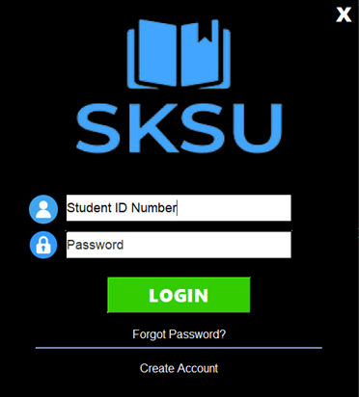
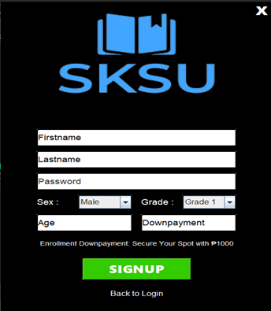
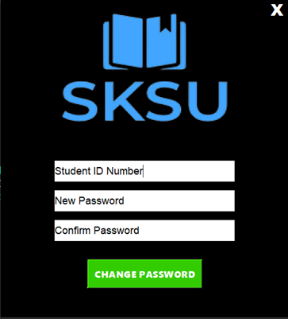
Flexible Login System
Implementing a flexible login system in the project allows users to regain access to their designated accounts even in the event of forgotten passwords. They can utilize their unique ID number to initiate the password reset process and establish a new one. This feature enhances user convenience and ensures account recovery.

Slide 5
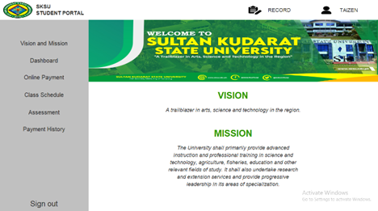
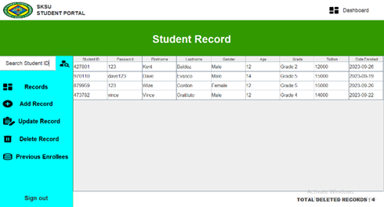
Efficient Data Access
The system provides a straightforward interface for the user to interact and navigate throughout their needed information with ease.

Slide 6
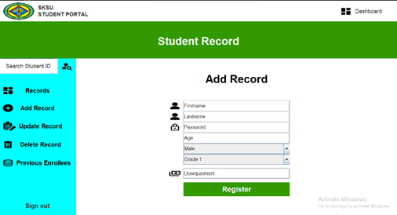
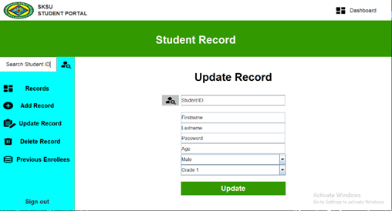
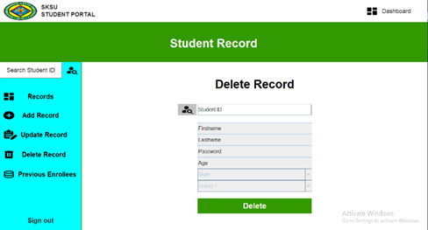
Efficient Student Record Manipulation
As for the administrator from the specified school, they could easily navigate and manipulate student data record or could be able to track an active and inactive account of the student.

Slide 7
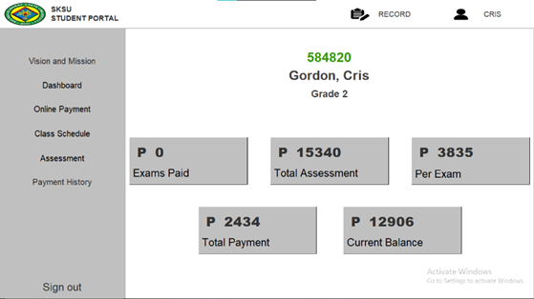
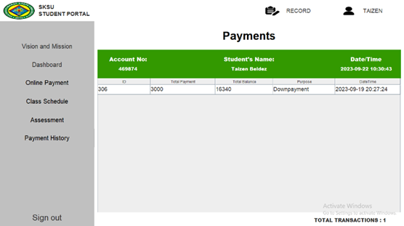
Personal Transaction Tracking and Local payment
The user can track their transactions within the school using either the hard copy of the specified payment or from their payment history.
If the user may not be able to directly pay to the school, they could simply decide to make their transaction with the local payment implemented within the system.

Slide 8
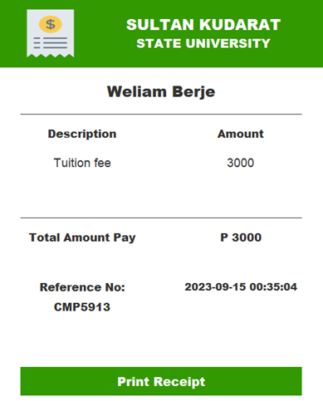
Receipt Generation
The program enables the user (either requested by the guardians or from the administration) to be provided with their finalized transaction together with their unique reference number formalizing the generation of a receipt.

Slide 9
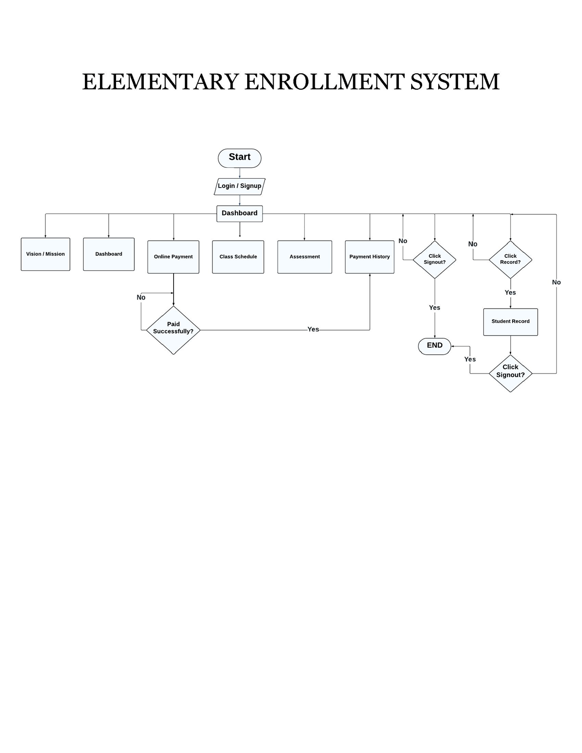
Flowchart Diagram

